Slide 1
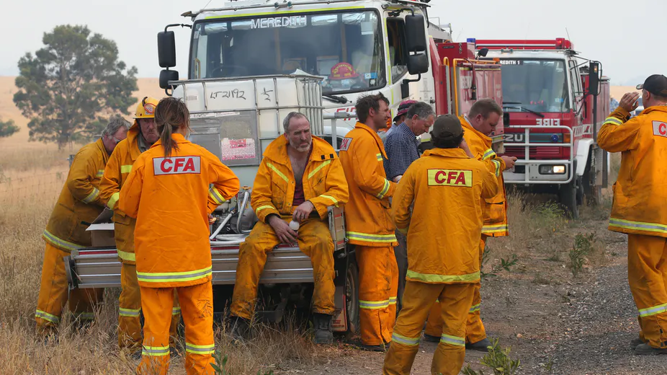
Broadening Horizons
By Jeff, Campbell and Faye 8S

Slide 2
If you only care about the solution skip to page 7

Slide 3
Definition of the Problem:
In summary, fire brigades across the countryside are struggling keep their volunteers interested in prolonged periods of time. This is since fires have been uncommon in the last and current semesters. Additionally, those equipped to train new recruits are also losing motivation as the connection they form with other members are quickly lost as they leave the brigade. Money spent on training recruits as well as resources are being wasted and not achieving extended use.

Slide 4
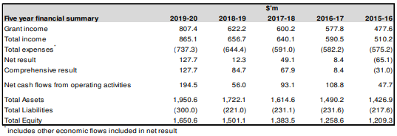
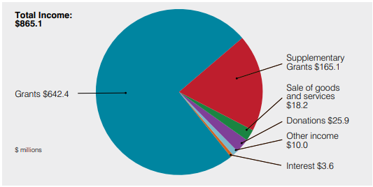
Money Related Statistics:
Due to the Country Fire Authority Act established in 1958, the CFA receives government funding that is put towards vehicles, uniforms, training, and other necessities. Additionally, the CFA generates a smaller amount of income via internal activities. Below is a more detailed description of where funding is currently being directed:

Slide 5
Information about the brigade
The CFA has 54,451 members. Typically, they spend around five to eight hours per week in the firehouse or responding to calls. If a volunteer firefighter is enrolled in an EMS (emergency medical services) certification program, they may speed 10-15 hours a week training at the firehouse. Junior CFA has more benefits like fun activities which include sleep overs, small competitions between junior recruits like races, and they are able to hang out which leads to them staying longer because they have friends in the CFA. CFA members have to manage relationships, engagement and education across local communities. Coordination of fundraising, campaigns, events and activities. CFA firefighters Media, promotion and publicity. Administration, logistical and financial support. CFA resources include 1,220 brigades, of which 941 are rural volunteer brigades, 204 urban volunteer brigades, 37 integrated brigades (stations manned by career firefighters and volunteer firefighters), 23 forest industry brigades, and 17 coast guard brigades.
2019-2020
1. Permanent operational staff 1411 |
2. Permanent support staff 1053 |
3. Volunteers – operational 30977 |
4. Volunteers – support 23818 |

Slide 6
The Iceberg

Slide 7
Our Solution
We plan to promote CFA Juniors in hope that it will create a flow of Volunteers coming through to seniors.
We also want to make CFA Juniors more fun, a couple of ideas could be:
- Making it like a sport with brigades up against each other
- Having more activities like sleepovers and camps (maybe like scouts)

Slide 8
How Can We Do This?
We came up with the idea for the CFA to request more money from the CFA budget to go through to Juniors so that it can be made the best experience for the kids, which would likely make them grow into the community and want to stay once they get to seniors.

Slide 9
What If That Doesn’t Work?
If our solution doesn’t work because we can’t get the money we have a couple of ideas how we can get it:
- The CFA Juniors can have fundraisers for the Junior brigades
-Our other idea is to get more money from the government and if that doesn’t work we have a website to aid the community

Slide 10
Sources:
https://www.cfa.vic.gov.au/about/annual-report
https://www.cfainstitute.org/en/programs/cfa/exam
https://www.cfa.vic.gov.au/volunteer-careers/volunteer-faqs
https://www.cfainstitute.org/en/about/press-releases/2019/more-than-21000-candidates-complete-cfa-program#:~:text=Currently%20more%20than%20167%2C000%20investment,I%20exam%2C%2041%20percent%20passed.
https://www.cfa.vic.gov.au/documents/20143/3558076/CFA_Annual+Report_2019.pdf/40909535-90f0-88a5-2642-c5d3a11bef60?t=1571280764479
https://www.cfa.vic.gov.au/about/history-timeline
https://news.cfa.vic.gov.au/-/i-love-cfa-juniors
https://www.cfa.vic.gov.au/about/supporting-cfa
https://www.cfa.vic.gov.au/about/supporting-cfa
https://jeffreypearson2000.wixsite.com/website

